Slide 1
Data Mining & Knowledge Discovery
IME 672
Lecture 8

Slide 2
Concepts & Methods
Clustering

Slide 3
Clustering
Cluster: A collection of data objects
Clustering: process of grouping a set of data objects into multiple groups or clusters so that
objects within a cluster have high similarity
but are very dissimilar to objects in other clusters
Unsupervised learning: no predefined classes (i.e., learning by observations)
Applications
Business intelligence – market segmentation, CRM
Image recognition – handwritten character recognition
Web search

Slide 4
Clustering
Applications
As a stand-alone tool to get insight into data distribution
As a preprocessing step for other algorithms
Outlier detection - credit card fraud
Challenges
Scalability
Ability to deal with different types of attributes
Discovery of clusters with arbitrary shape
Requirements for domain knowledge to determine input parameters
Ability to deal with noisy data
Incremental clustering and insensitivity to input order

Slide 5
Considerations for Cluster Analysis
Partitioning criteria
Single level vs. hierarchical partitioning (often, multi-level hierarchical partitioning is desirable)
Separation of clusters
Exclusive (e.g., one customer belongs to only one region) vs. non-exclusive (e.g., one document may belong to more than one class)
Similarity measure
Distance-based (e.g., Euclidian, road network, vector) vs. connectivity-based (e.g., density or contiguity)
Clustering space
Full space (often when low dimensional) vs. subspaces (often in high-dimensional clustering)

Slide 6
Major Clustering Approaches
Partitioning approach
Construct various partitions and then evaluate them by some criterion, e.g., minimizing the sum of square errors
Typical methods: k-means, k-medoids, CLARANS
Hierarchical approach
Create a hierarchical decomposition of the set of data (or objects) using some criterion
Typical methods: Diana, Agnes, BIRCH, CAMELEON
Density-based approach
Based on connectivity and density functions
Typical methods: DBSACN, OPTICS, DenClue
Grid-based approach
Based on a multiple-level granularity structure
Typical methods: STING, WaveCluster, CLIQUE

Slide 7
Partitioning Algorithms
Given a data set, D, of n objects, and k, the number of clusters to form, a partitioning algorithm organizes the objects into k partitions (k<=n), where each partition represents a cluster
Sum of squared distances is minimized (where c_{i} is the centroid or medoid of cluster C_{i})
Find a partition of k clusters that optimizes the chosen partitioning criterion
Global optimal: exhaustively enumerate all partitions
Heuristic methods: k-means and k-medoids algorithms
k-means: Each cluster is represented by the center of the cluster
k-medoids or PAM (Partition around medoids): Each cluster is represented by one of the objects in the cluster

Slide 8
k-Means Clustering Method
Given k, the k-means algorithm is implemented in four steps:
Partition objects into k nonempty subsets
Compute seed points as the centroids of the clusters of the current partitioning (the centroid is the center, i.e., mean point, of the cluster)
Assign each object to the cluster with the nearest seed point
Stop if the assignment does not change. Otherwise go to Step 2

Slide 9
k-Means Clustering - Illustration
K=2
Arbitrarily partition objects into k groups
Update the cluster centroids
The initial data set
Reassign objects
Loop if needed
Update the cluster centroids

Slide 10
k-Means: Comments
Strength
Efficient: O(tkn), where n is # objects, k is # clusters, and t is # iterations. Normally, k, t << n
Weakness
Often terminates at a local optima
Applicable only to objects in a continuous n-dimensional space
k-modes method for categorical data
Need to specify k, the number of clusters, in advance
Sensitive to noisy data and outliers
Not suitable to discover clusters with non-convex shapes

Slide 11

k-Medoids Clustering Method
Instead of taking the mean value of the objects in a cluster as a reference point, actual object is used
Absolute-error criterion is used
10
10
9
9
8
8
7
7
6
6
5
5
4
4
3
3
2
2
1
1
0
0
1
2
3
4
5
6
7
8
9
10
0
0
1
2
3
4
5
6
7
8
9
10

Slide 12
k-Medoid Clustering Method
Find representative objects (medoids) in clusters
PAM (Partitioning Around Medoids)
Starts from an initial set of medoids and iteratively replaces one of the medoids by one of the non-medoids if it improves the total distance of the resulting clustering
PAM works effectively for small data sets, but does not scale well for large data sets (due to the computational complexity)

Slide 13
k-Medoids Algorithm: Illustration
Total Cost = 20
10
9
8
Arbitrary choose k object as initial medoids
Assign each remaining object to nearest medoids
7
6
5
4
3
2
1
0
0
1
2
3
4
5
6
7
8
9
10
K=2
Randomly select a nonmedoid object,O_{ramdom}
Total Cost = 26
Do loop
Until no change
10
10
9
Compute total cost of swapping
9
Swapping O and O_{ramdom}
If quality is improved.
8
8
7
7
6
6
5
5
4
4
3
3
2
2
1
1
0
0
1
2
3
4
5
6
7
8
9
10
0
0
1
2
3
4
5
6
7
8
9
10
Notes:
13

Slide 14
Hierarchical Methods
Group data objects into a hierarchy or “tree” of clusters
Useful for data summarization and visualization
Does not require the number of clusters k as an input
Needs a termination condition
Methods – agglomerative, divisive, BIRCH, Chameleon

Slide 15
Agglomerative Hierarchical Clustering
Hierarchical decomposition is formed in a bottom-up (merging) fashion
Approach
Starts by letting each object form its own cluster
Iteratively merges clusters into larger and larger clusters, until all the objects are in a single cluster (root) or certain termination conditions are satisfied
For merging, finds two clusters that are closest to each other and combines them
Requires at most n iterations

Slide 16
Divisive Hierarchical Clustering
Hierarchical decomposition is formed in a top-down (splitting) fashion
Approach
Starts by placing all objects in one cluster (root)
Divides the root cluster into several smaller sub-clusters recursively
Partitioning continues until each cluster at the lowest level either contains only one object, or the objects within a cluster are sufficiently similar to each other

Slide 17
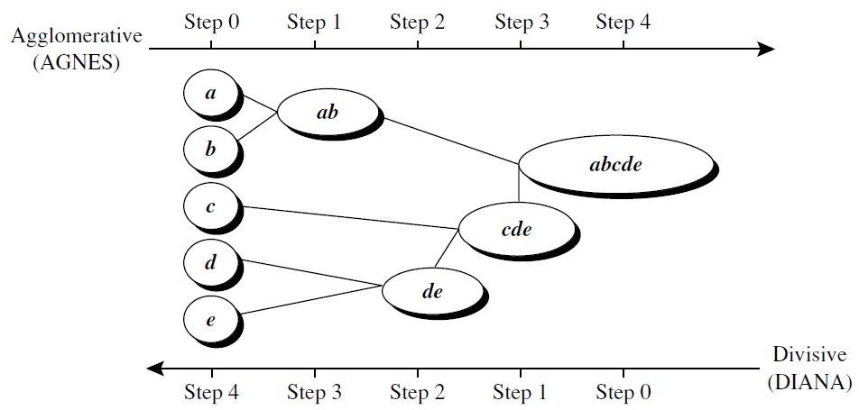
Agglomerative vs. Divisive

Slide 18
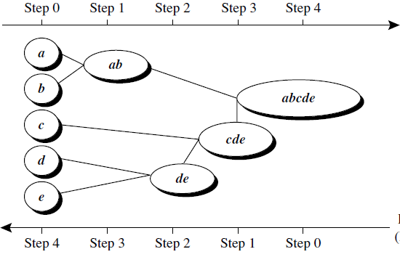
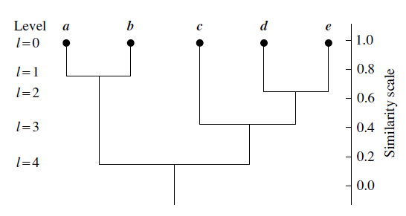
Dendrogram
A tree structure representing the process of hierarchical clustering

